Slide 1

INTRODUCTION

Slide 2
SESSION OVERVIEW:
HISTORY
FEATURES
INTERPRETER
KEYWORDS & IDENTIFIERS
MEMORY MANAGEMENT

Slide 3
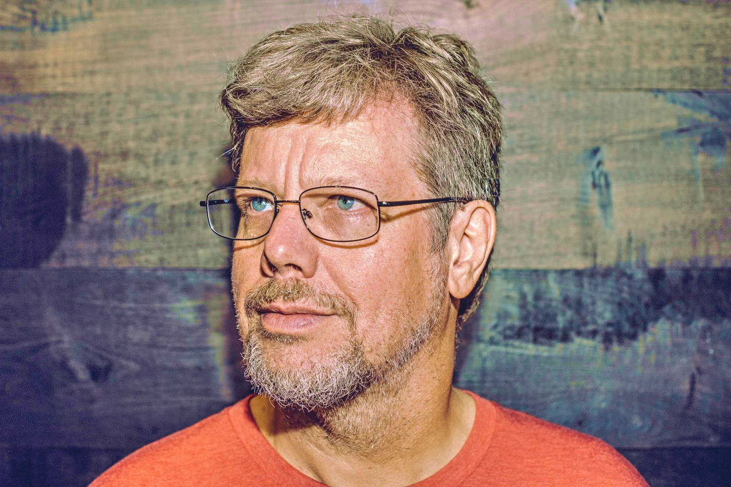
HISTORY:
PYTHON WAS DEVELOPED BY GUIDO VAN ROSSUM.
DURING 1985 – 1990.

Slide 4
FEATURES:
HIGH LEVEL LANGUAGE
INTERPRETED
INTERACTIVE
OBJECT ORIENTED
SCRIPTING LANGUAGE
BEGINNER’S LANGUAGE

Slide 5
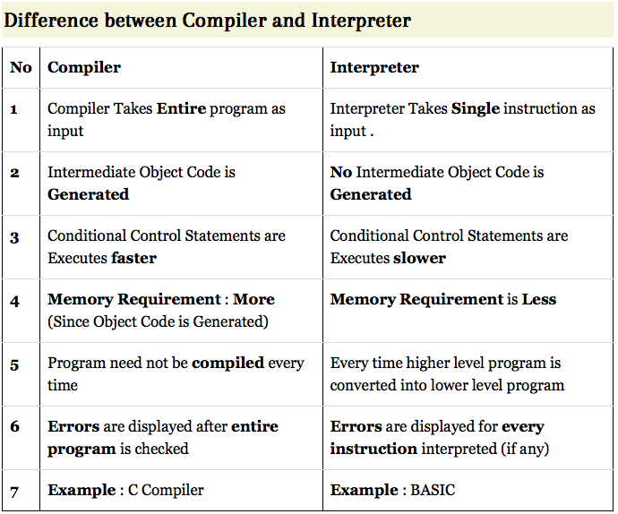

Slide 6
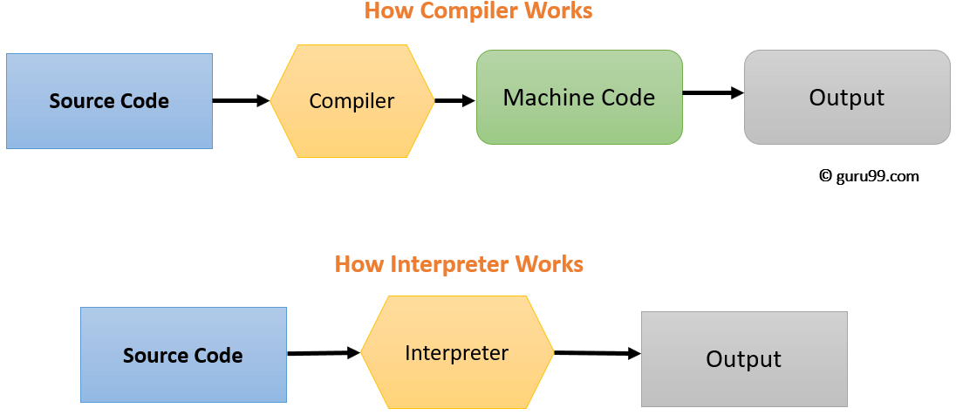
INTERPRETER:
2 MODES :
INTERACTIVE MODE
SCRIPT MODE

Slide 7
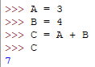


2 WAYS OF USING PYTHON:
INTERACTIVE MODE
SCRIPT MODE

Slide 8
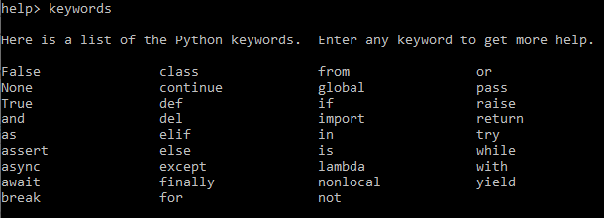
KEYWORDS: (35) MAR 2021

Slide 9
NOTE:
As Python Is Ever Growing & Evolving Programming Language
THE List Of Keywords & Many Functions May Get Updated.
Always Note The Version Of Python You Are Using.

Slide 10
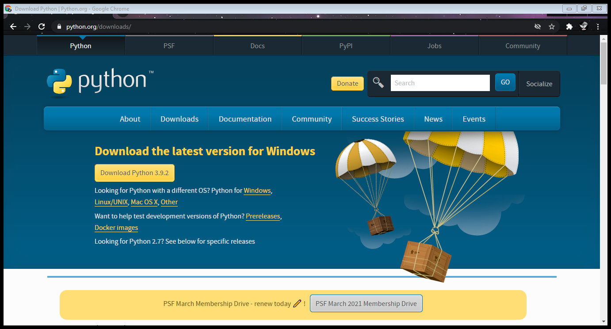

Slide 11
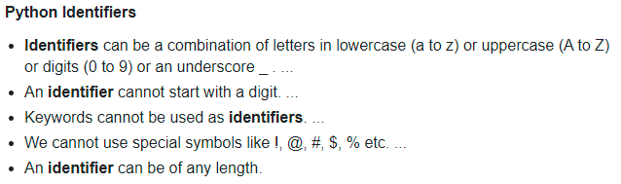
IDENTIFIERS:
Identifiers Are Variables Names
RULES :

Slide 12
MEMORY MANAGEMENT:
Variables are not declared ahead of time
Variables types are not declared
No memory management on coder’s part
Variable names can be recycled
Del statement allows for explicit “de-allocation”

Slide 13
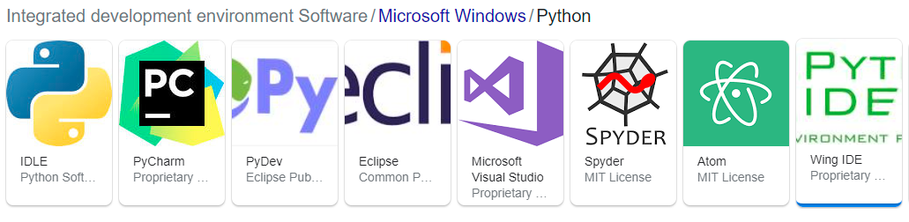
IDE = Integrated Development Environment
As Python is Widely Used in the World , There are Many IDEs & Many Online Compliers too.
Some of the Most Efficient & User Friendly are :

Slide 14

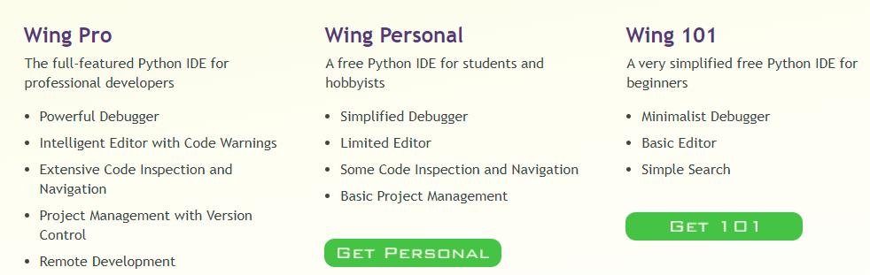
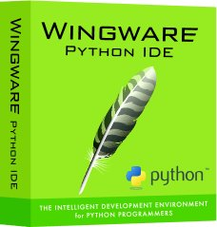

Slide 15
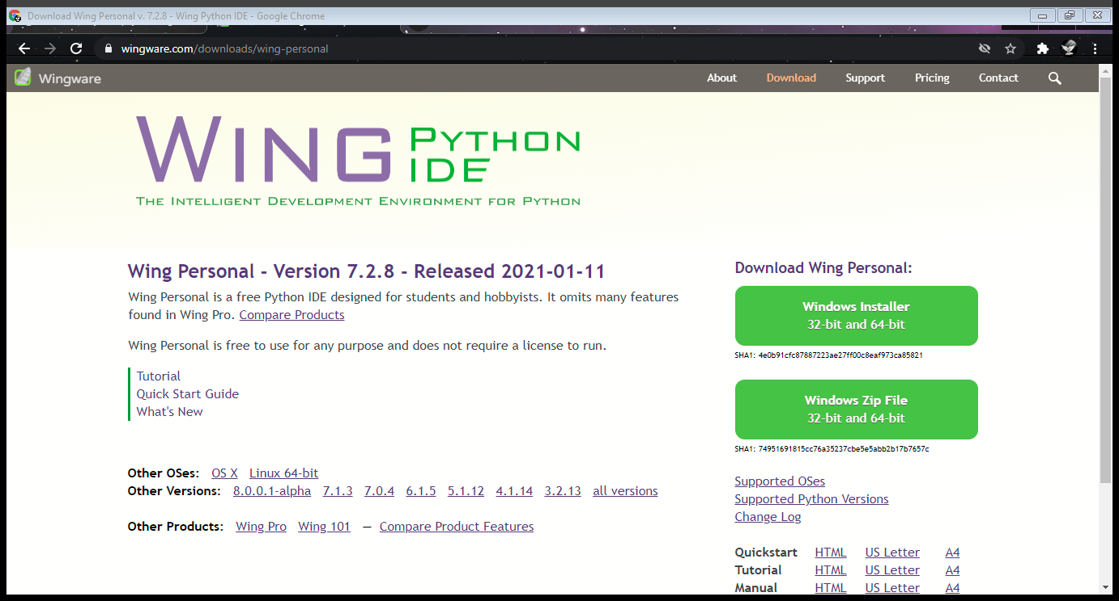
MARCH 2021

Slide 16
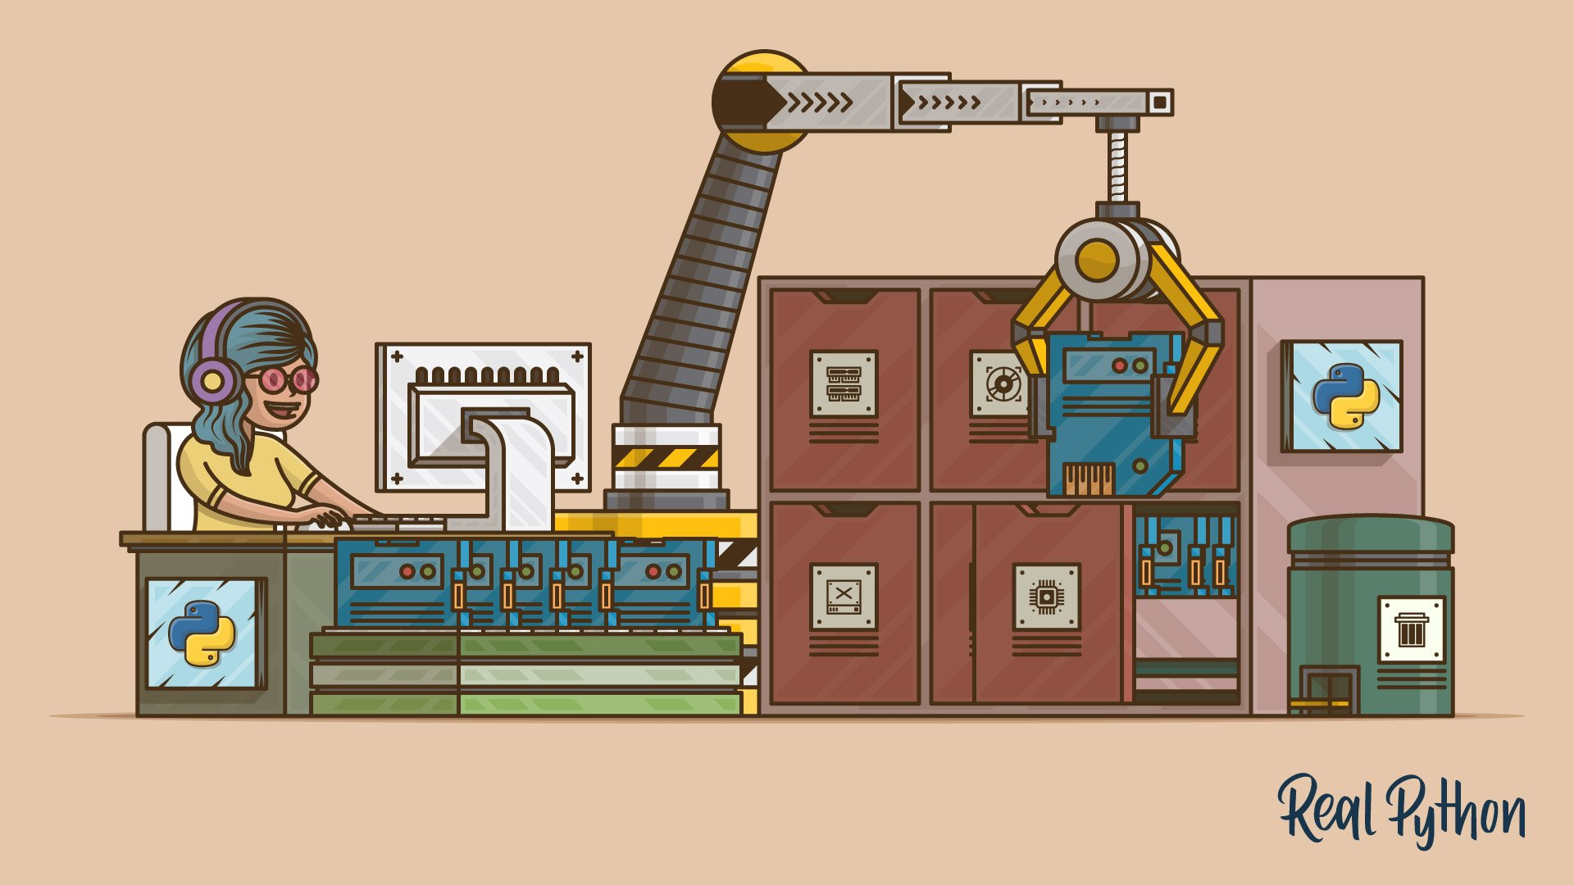
CODING IS FUN ! THANK YOU !!

